Slide 1
ROBOT MAPPING AND EKF SLAM

Slide 2
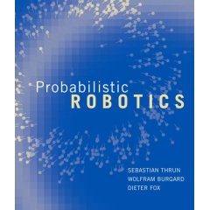
Slides for the book:
Probabilistic Robotics
Authors:
  Sebastian Thrun
  Wolfram Burgard
  Dieter Fox
Publisher:
  MIT Press, 2005.
Web site for the book & more slides:
http://www.probabilistic-robotics.org/

Slide 3
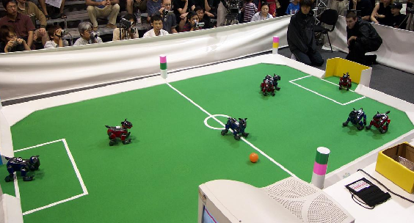
Landmark-based Localization

Slide 4
Extended Kalman Filters

Slide 5
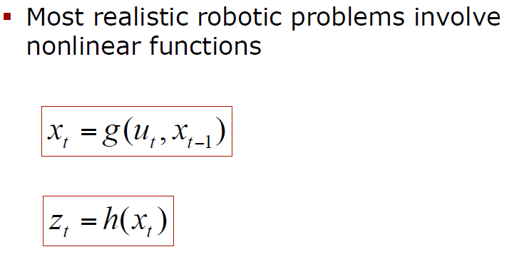
Nonlinear Dynamic Systems
nonlinear

Slide 6
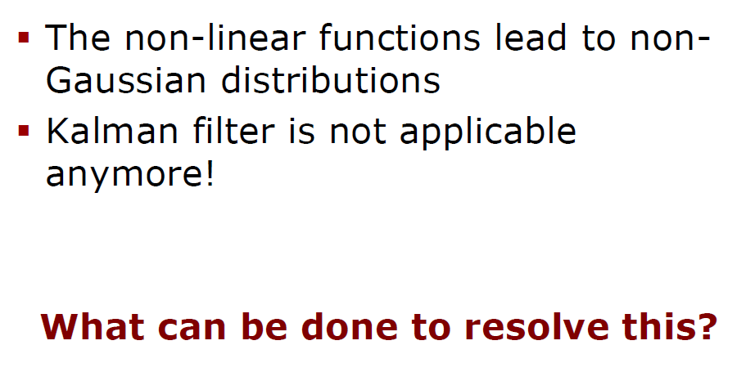
Non-Gaussian Distributions in Kalman filters?

Slide 7
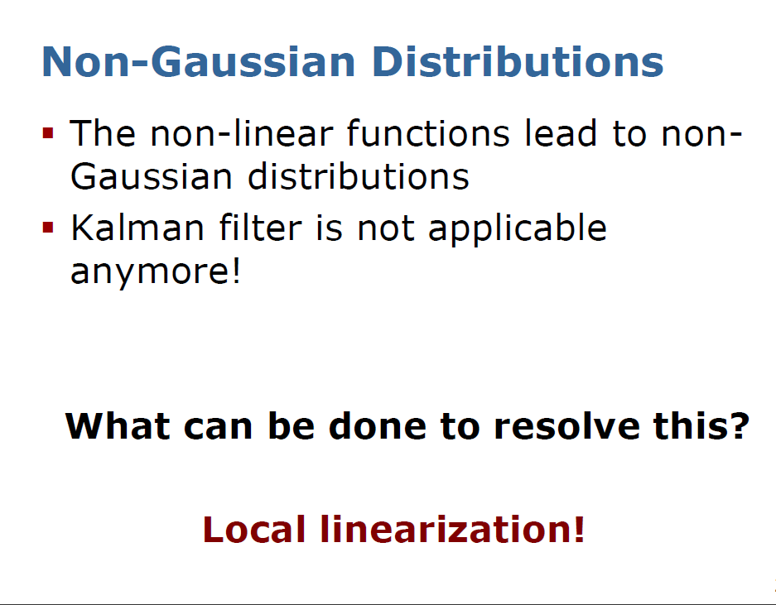
Last slide main observation
We use Taylor expansion to linearize

Slide 8
First Order Taylor Expansions

Slide 9
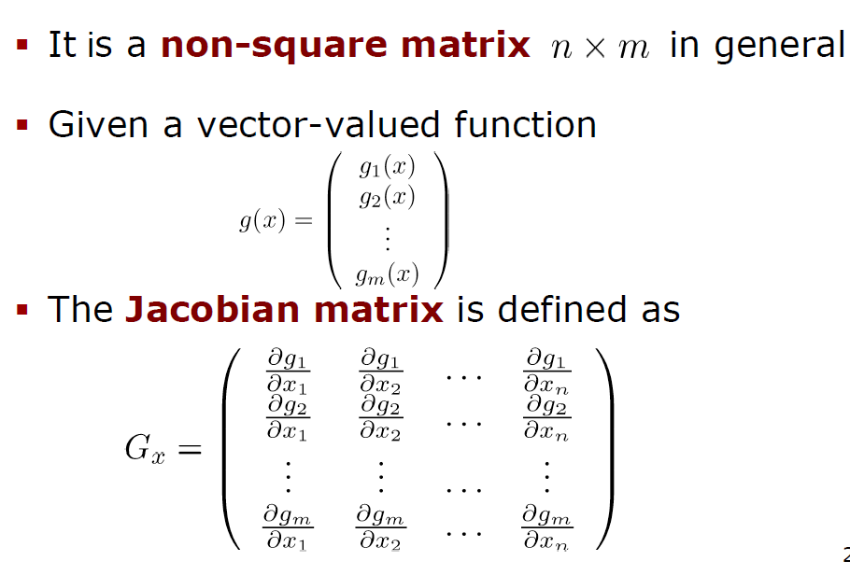
Reminder: Jacobian Matrix
nonlinear
x=(x₁,x₂,…,x_{n})
Tangent plane represents multi-dimensional derivative

Slide 10
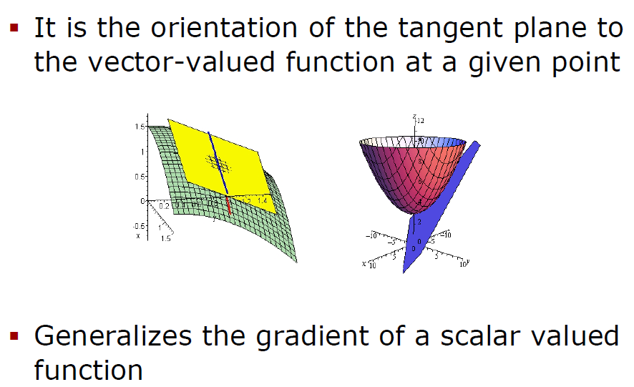
Reminder: Jacobian Matrix
Jacobian Matrix represents the gradient of a scalar valued function

Slide 11
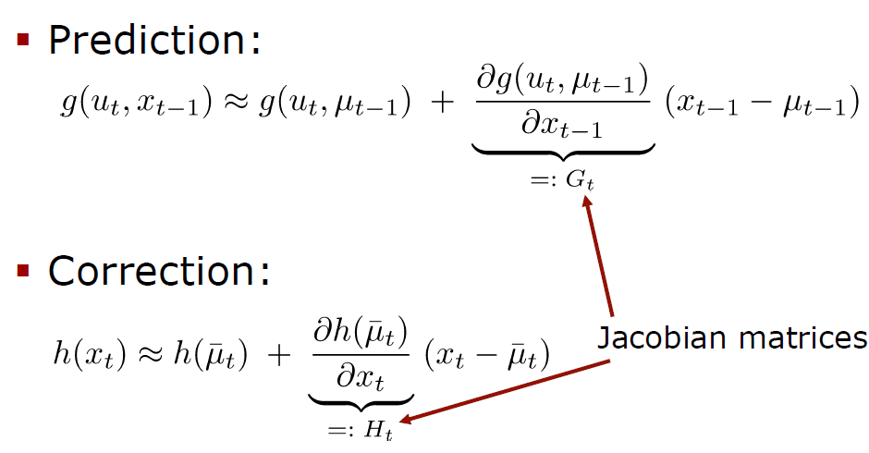
EKF Linearization is done through First Order Taylor Expansion
Linearization for prediction
Linearization for correction

Slide 12

matrix
vector
vector
Matrix-vector multiplication again

Slide 13
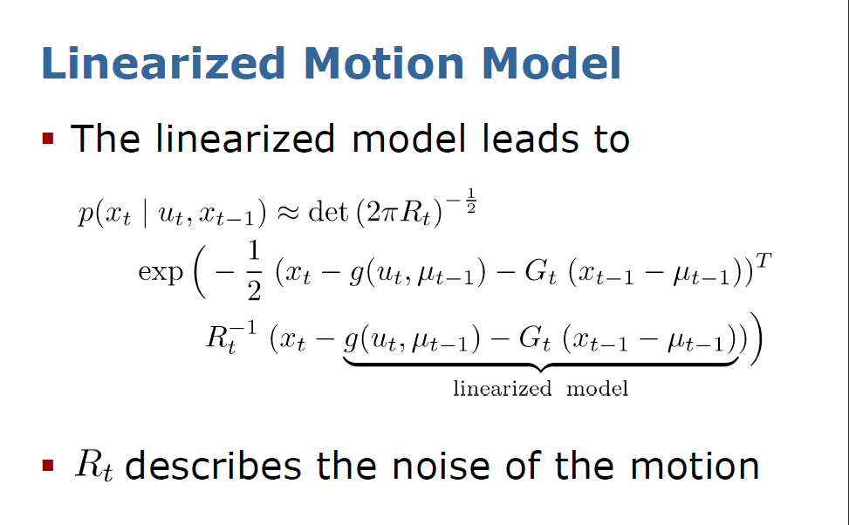
nonlinear
From previous slide
(
)
(
)
When we insert to Kalman filter equations

Slide 14
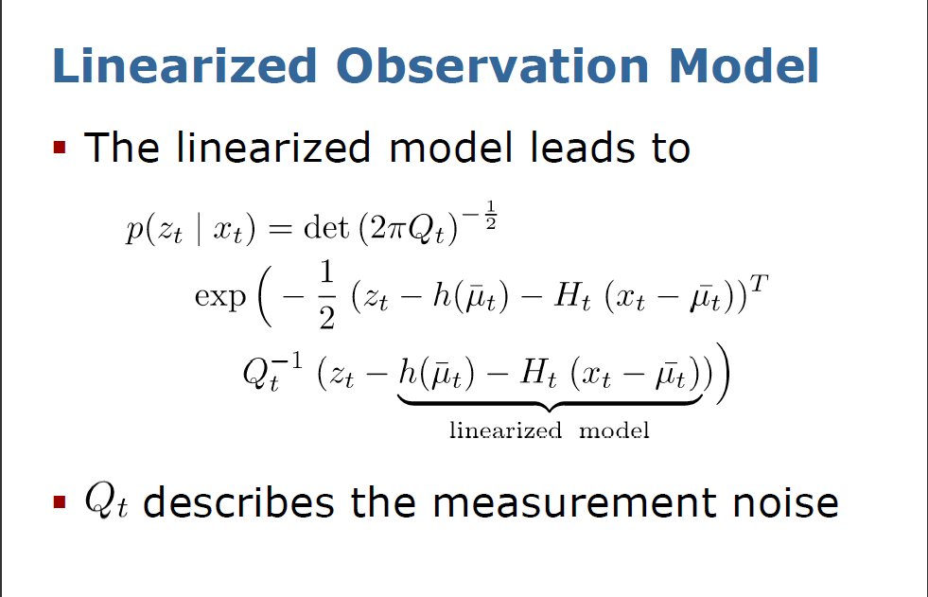
nonlinear
From previous slide
(
)
When we insert to Kalman filter equations

Slide 15
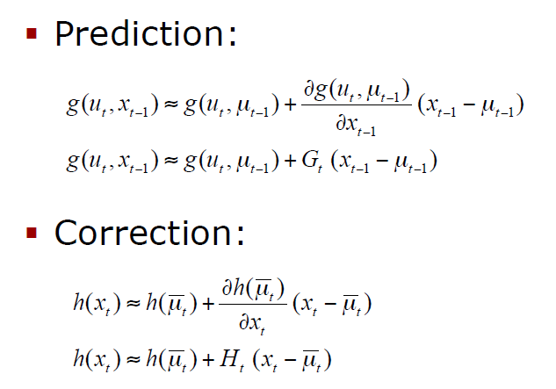
EKF Linearization: First Order Taylor Series Expansion. Matrix vs Scalar
Scalar case
MATRIX case

Slide 16
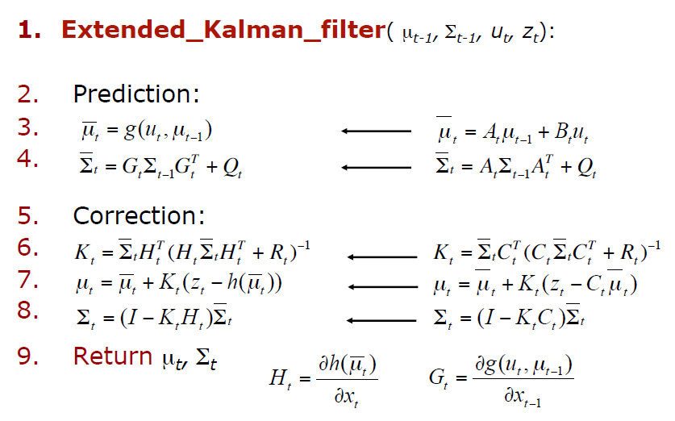
EKF Algorithm compared with Kalman Algorithm
Was in linear Kalman

Slide 17
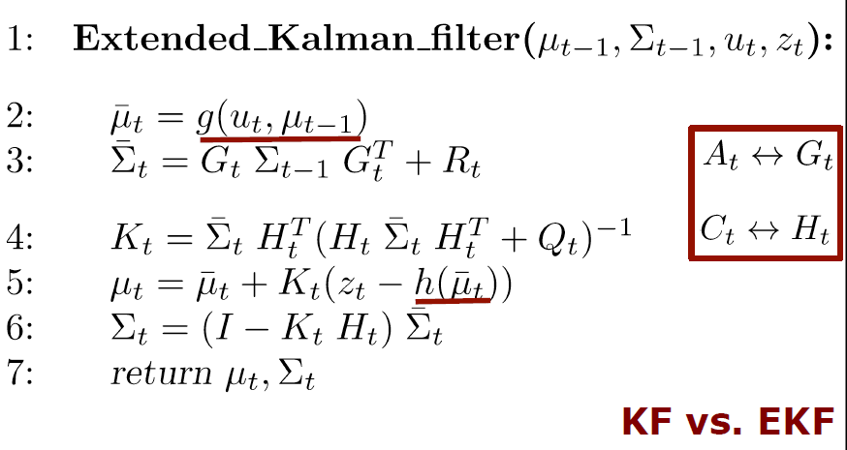
Extended Kalman Filter Algorithm

Slide 18
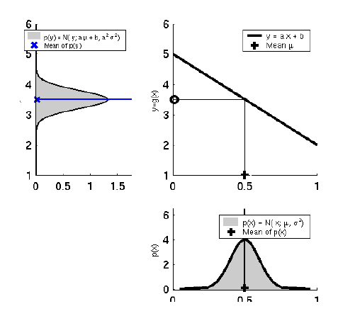
Linearity Assumption Revisited
Grey represents true distribution of p(y)
Linear mapping of Mean: y=ax+b
This is ideal case of pushing gaussian through a linear system
Mean of p(y)
Mean of p(x)

Slide 19
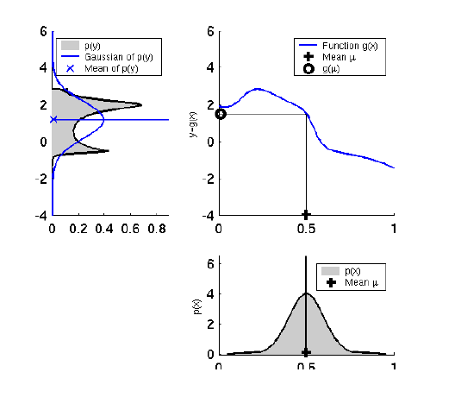
Non-linear Function
Grey represents true distribution of p(y)
Non-linear function g(x)
This is a real case of pushing a gaussian through a non-linear system
Gaussian of p(y)
We are approximating grey by blue, not good
Mean of p(x)

Slide 20
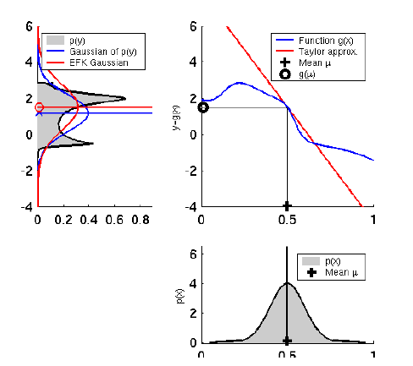
EKF Linearization (1):
Taylor approximation and EKF Gaussian
This example shows that Gaussian of EKF better represents estimated value than the Gaussian mean
Better than in last slide.
The mean is closer to grey shape

Slide 21

EKF Linearization (2)
Now the height is reduced to 2.
More uncertainty
EKF even better

Slide 22
EKF Linearization (3)
Even more difference of EKF Gaussian and real Gaussian, but better estimation
Smaller max value

Slide 23
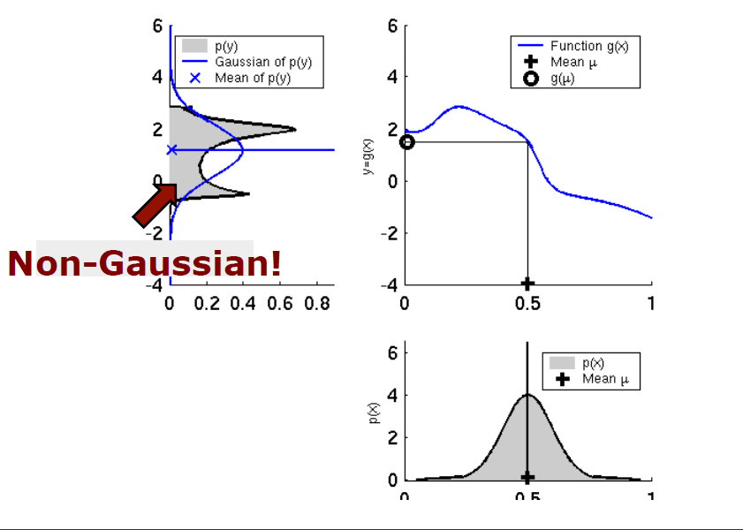
Conclusion: NON-GAUSSIAN distribution of output requires EKF or something better that would calculate the mean better
In this case the input Gaussian does not create an output Gaussian!
And Gaussian estimation of output is worse than EKF estimation of Gaussian with respect to mean
Gaussian with high value of standard deviation

Slide 24
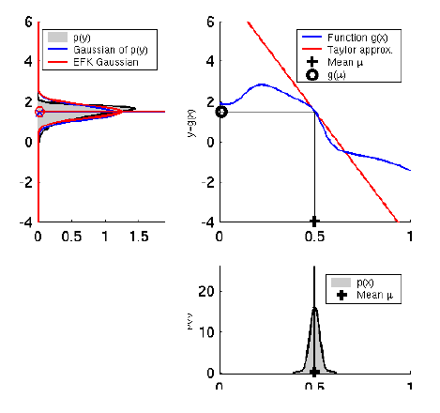
EKF Linearization (5)
Gaussian similar to EKF gaussian
In this case EKF works similarly to KF
Narrow and short gaussian

Slide 25
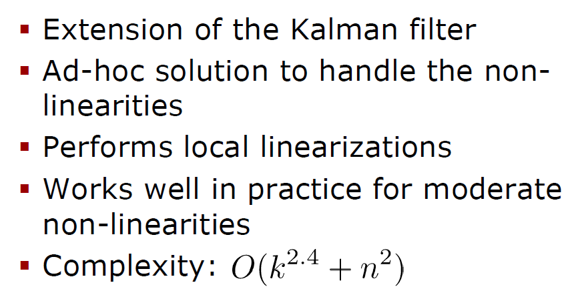
Summary on Extended Kalman Filters

Slide 26
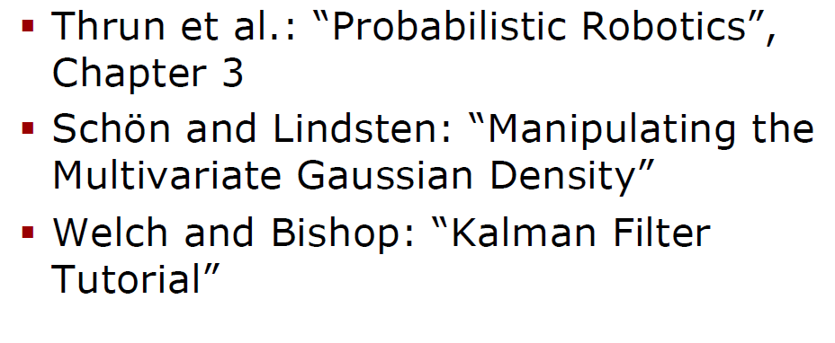
Literature on Kalman Filter and EKF

Slide 27
EKF Localization Example

Slide 28
Localization of two-dimensional robot
“Using sensory information to locate the robot in its environment is the most fundamental problem to providing a mobile robot with autonomous capabilities.” [Cox ’91]
Given
  Map of the environment.
  Sequence of sensor measurements.
Wanted
  Estimate of the robot’s position.
Problem classes
  Position tracking
  Global localization
  Kidnapped robot problem (recovery)

Slide 29
EKF_localization ( μ_{t-1}, Σ_{t-1}, u_{t}, z_{t}, m):
Prediction Phase:
(x,y,Θ)
Jacobian of g w.r.t location
velocity
Velocity and radial velocity are controls
Radial velocity
Jacobian of g w.r.t control
Motion noise
Predicted mean
Predicted covariance

Slide 30
EKF_localization ( μ_{t-1}, Σ_{t-1}, u_{t}, z_{t}, m):
Correction phase:
r = range
ϕ = angle
Predicted measurement mean
Jacobian of h w.r.t location
Pred. measurement covariance
Kalman gain
Updated mean
Updated covariance

Slide 31
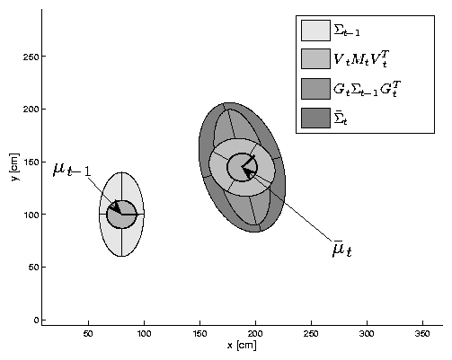
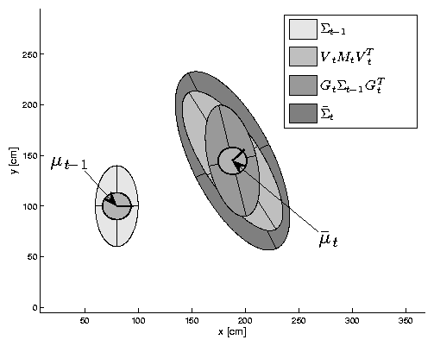
EKF Prediction Step for four cases
Updated mean
Updated covariance
Predicted mean
Predicted covariance

Slide 32
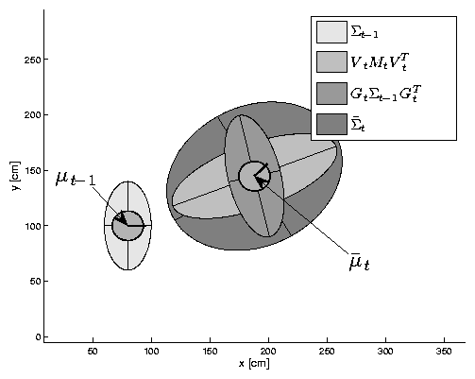
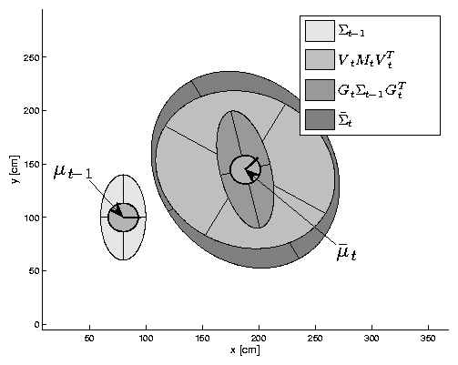
EKF Prediction Step for four cases: now we take other system
Predicted mean
Predicted covariance
Updated mean
Updated covariance

Slide 33
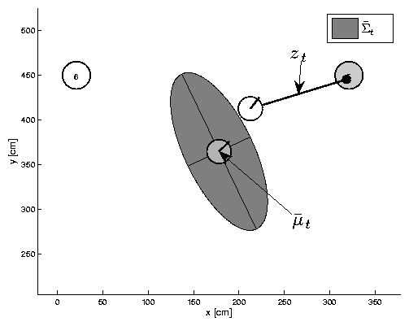
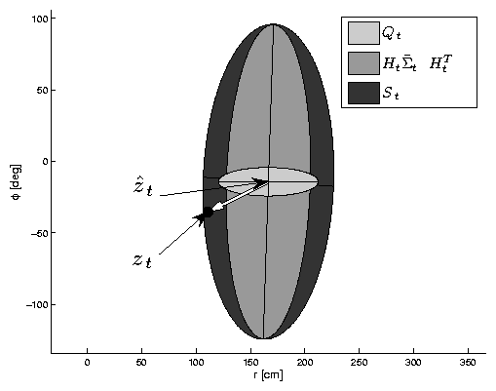
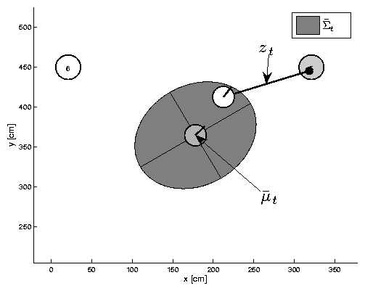
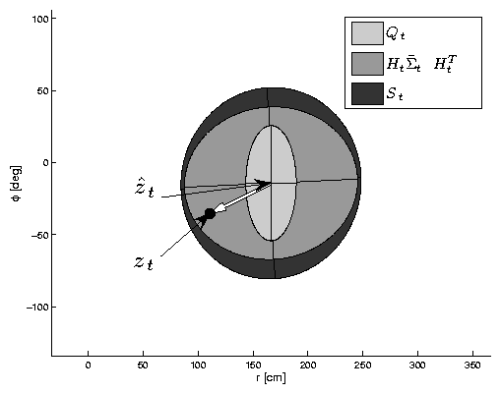
EKF Observation Prediction Step
robot
landmark
Z = measurement
Similarly for three other cases but sizes and shapes are different
Predicted robot covariance

Slide 34
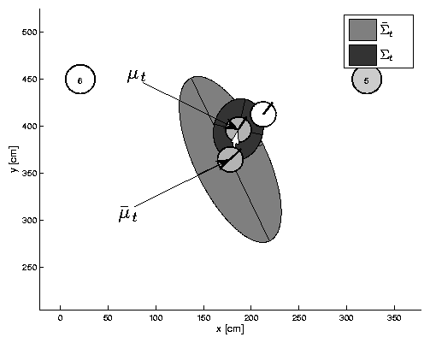
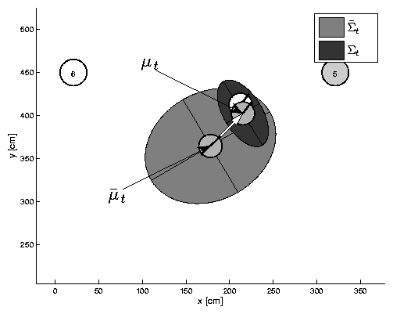
EKF Correction Step

Slide 35
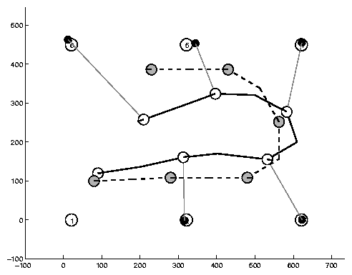
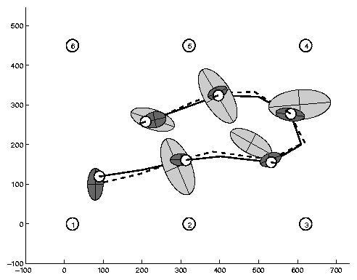
Estimation Sequence (1)
Based on measurement only
Based on Kalman
Initial true robot
landmark
Initial estimated robot

Slide 36
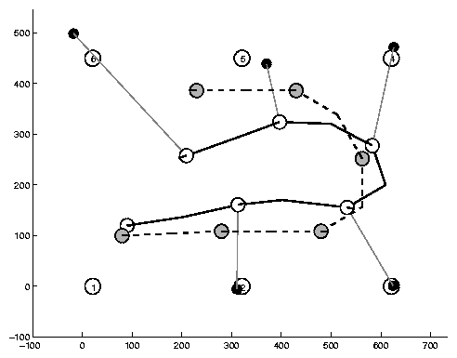
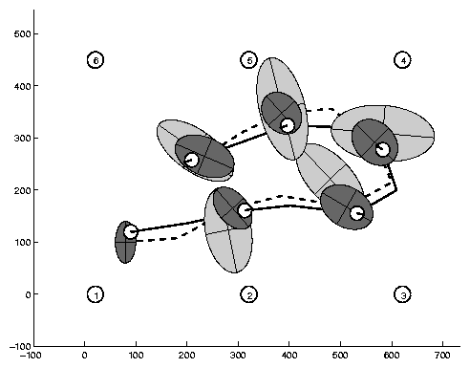
Estimation Sequence (2)
And we see a difference between estimated and real positions of the robot

Slide 37
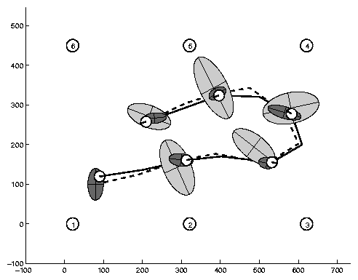
Comparison to GroundTruth

Slide 38
EKF Summary
Highly efficient: Polynomial in measurement dimensionality k and state dimensionality n:
O(k^{2.376} + n²)
Not optimal!
Can diverge if nonlinearities are large!
Works surprisingly well even when all assumptions are violated!

Slide 39
SLAM Review

Slide 40
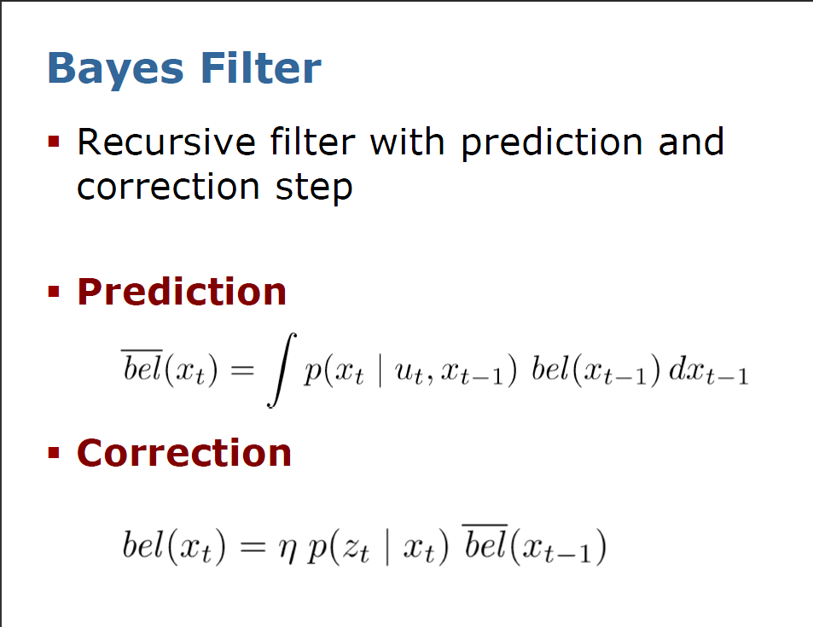

Slide 41
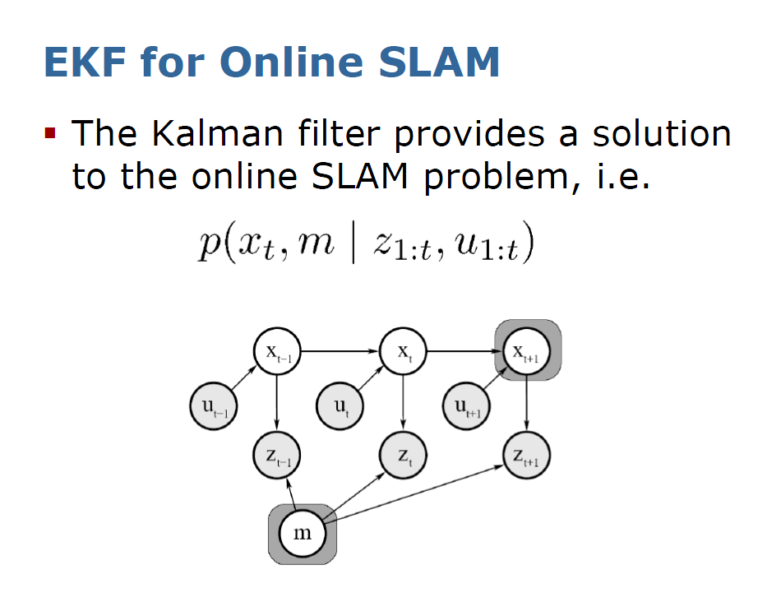

Slide 42
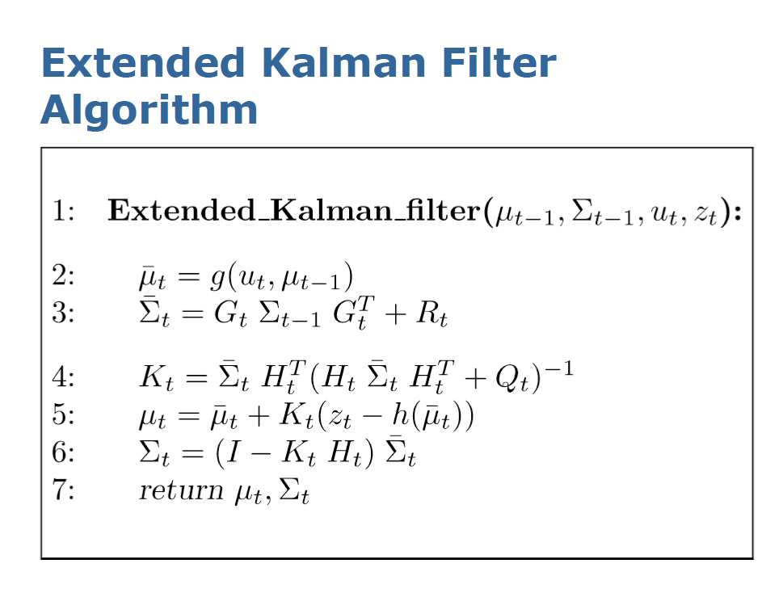
Noise in motion
Noise in measurement

Slide 43
EKF SLAM

Slide 44
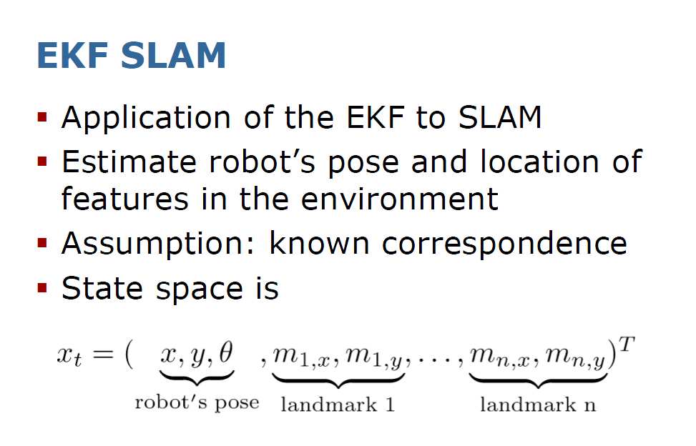
State vector has size 3+2n
3 coordinates for robot’s pose
2N coordinates for N features

Slide 45
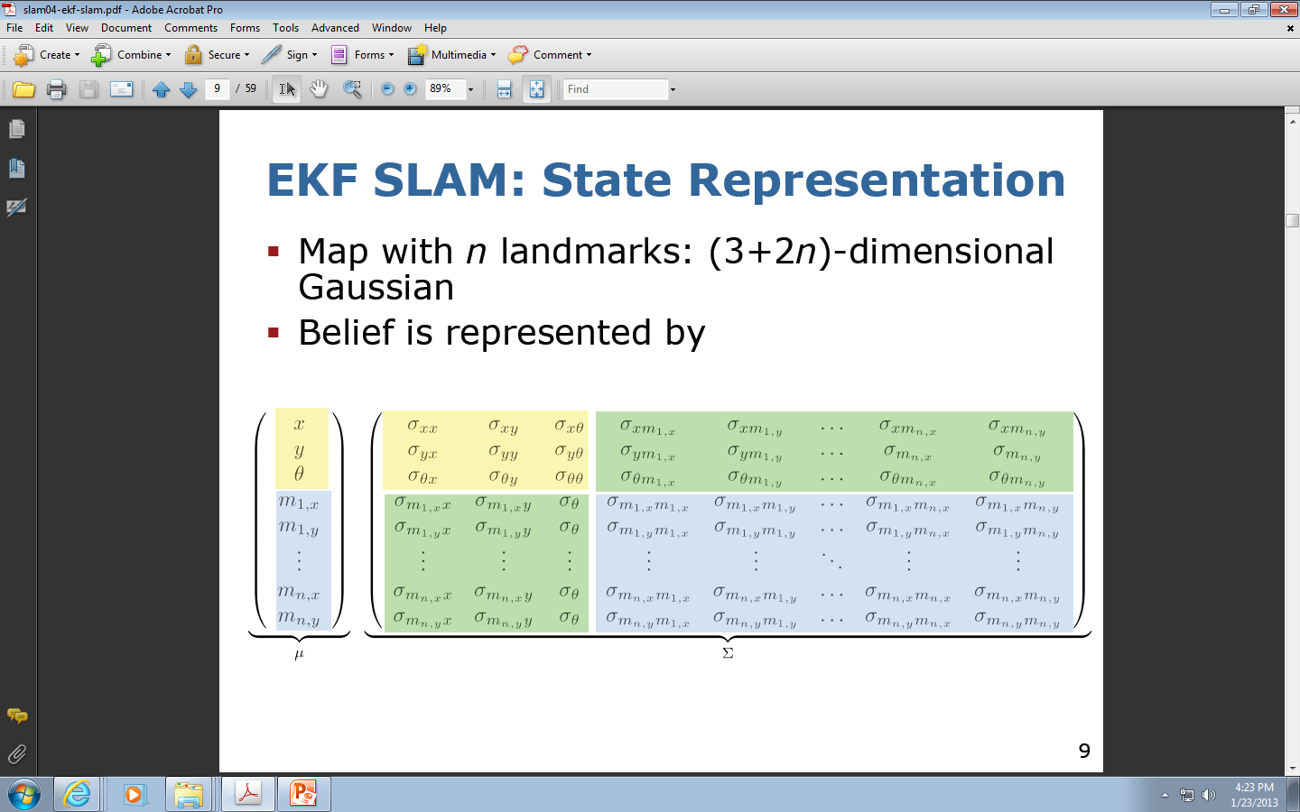
State Representation for EKF SLAM
Mean Value Matrix (Vector)
Covariance matrix

Slide 46
State Representation for EKF SLAM
Please observe how these matrices are partitioned to submatrices
Covariance matrix
Mean Value Matrix

Slide 47
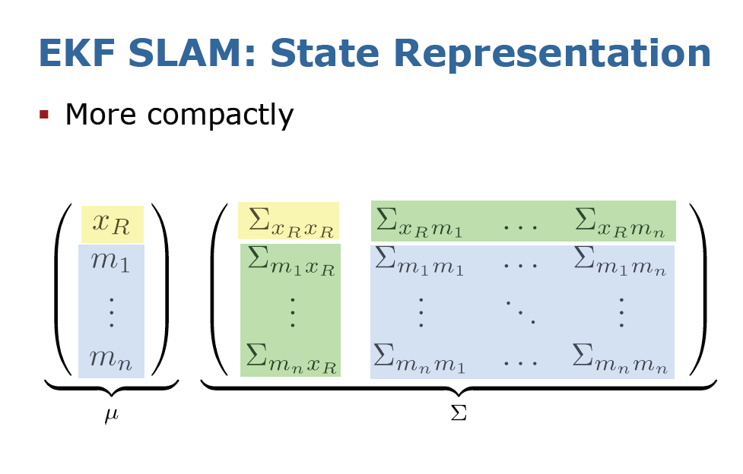
Just another notation for the same stuff as in last slide

Slide 48
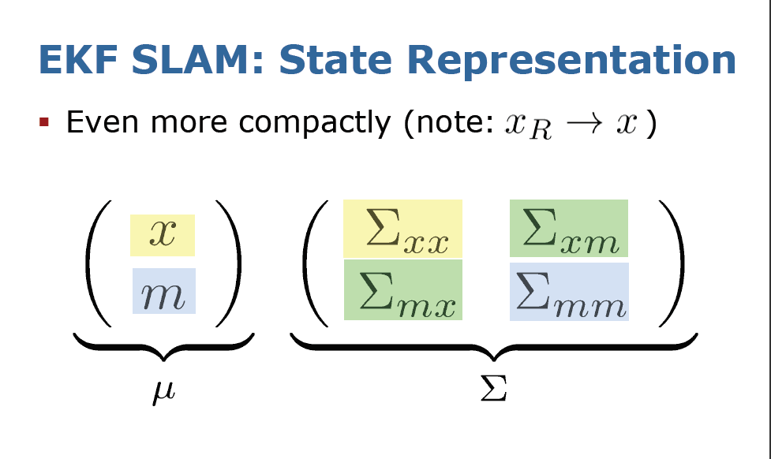
One more often used notation for the same stuff as in last slide

Slide 49
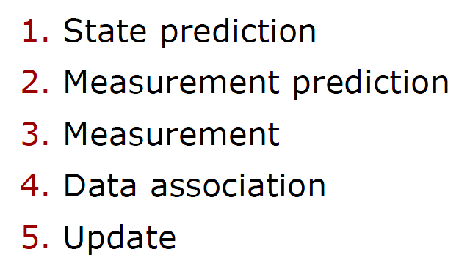
Filter Cycle for the EKF SLAM

Slide 50
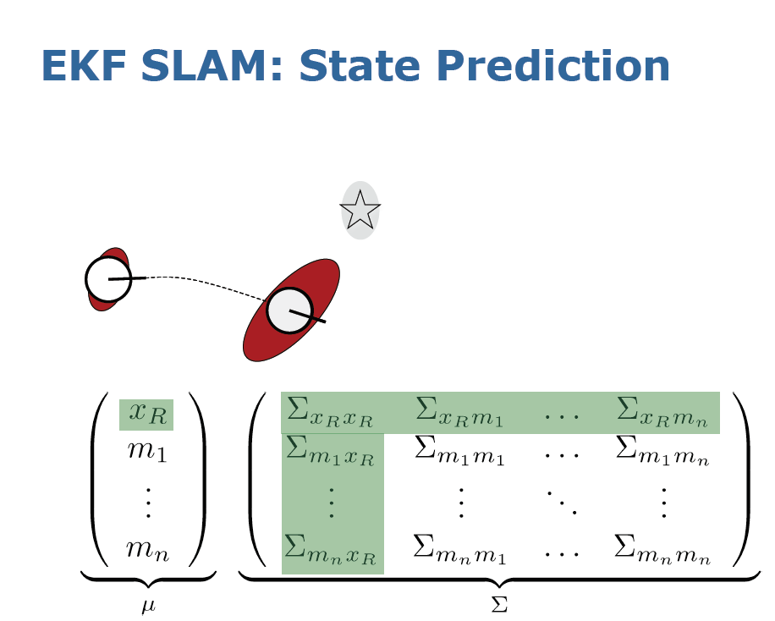
In green we show the part related to state prediction

Slide 51
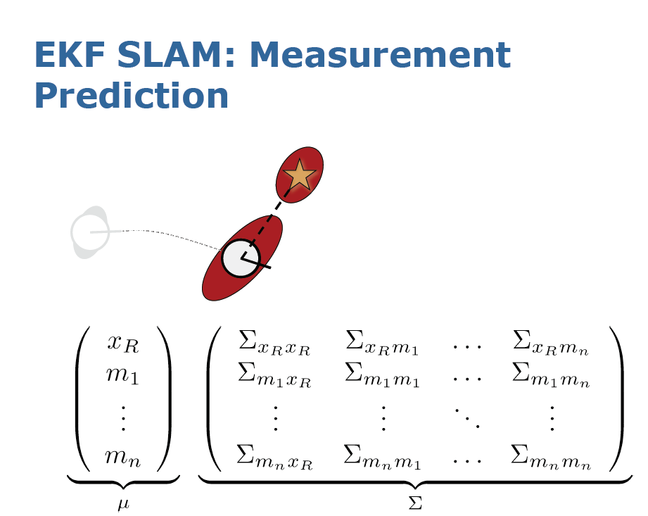

Slide 52
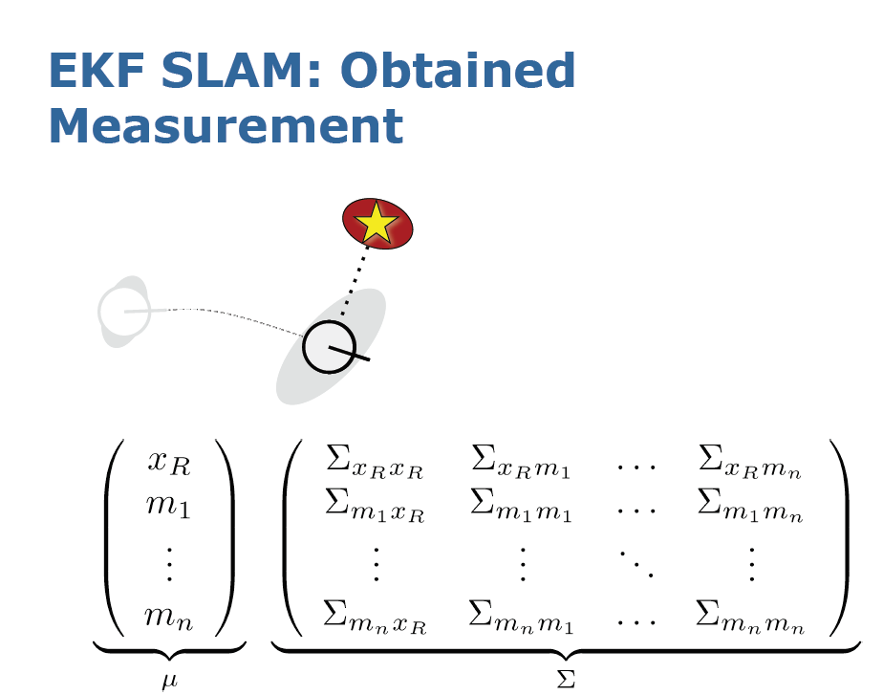

Slide 53
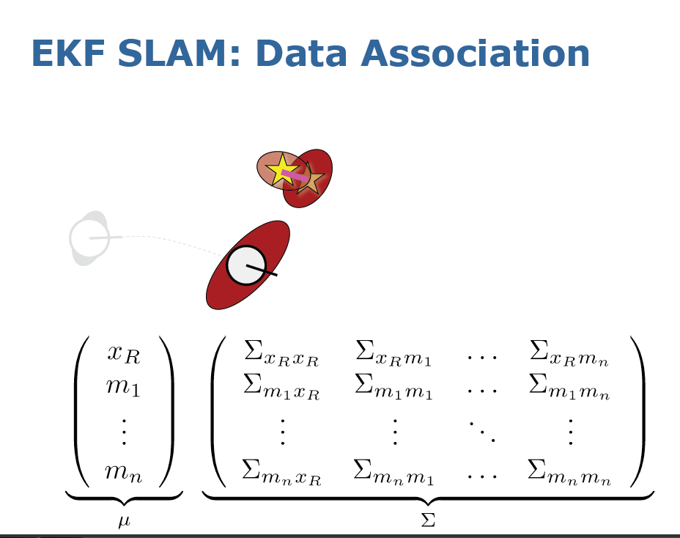

Slide 54
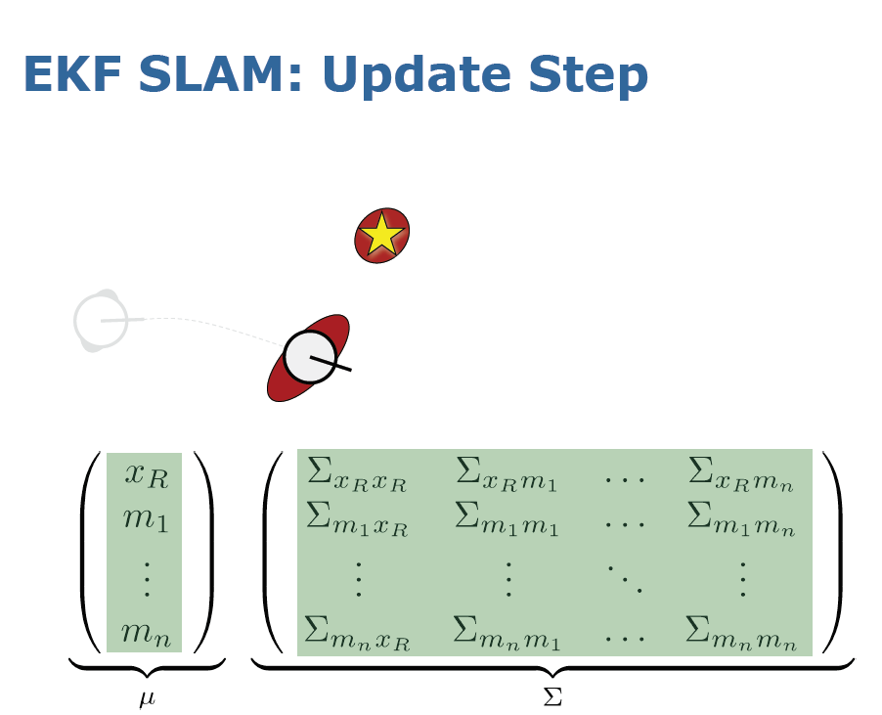
Now in green we have new estimated state and new estimated covariance matrix

Slide 55
A concrete example of EKF SLAM

Slide 56
EKF-SLAM: a concrete example of robot on a plane
Robot moves in the plane
Velocity-based motion model:
  V = speed
  ω = radial velocity
Robot observes point landmarks
Range-bearing sensor
Known data association to landmark points
Known number of landmarks.

Slide 57
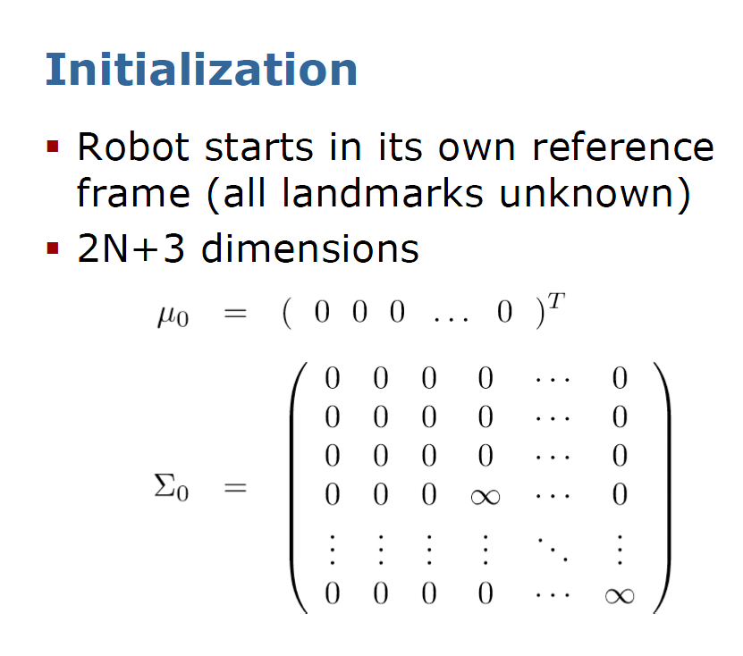
State Vector of mean estimates
N landmarks
Covariance matrix
Nothing known about landmarks

Slide 58
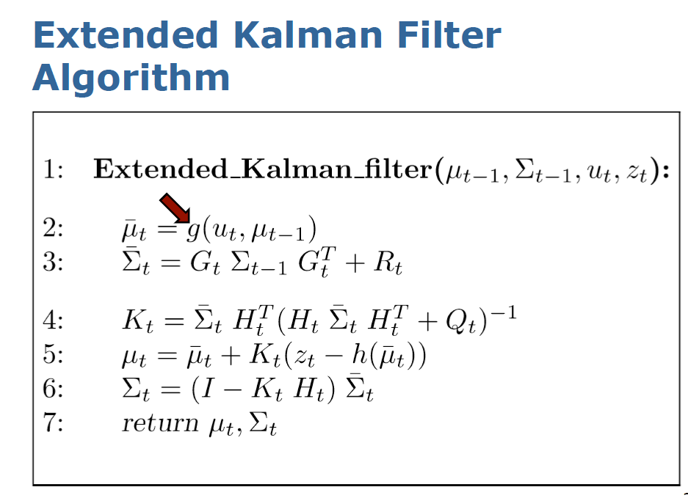

Slide 59


Slide 60

Last slide
Remember notations F ^{T} _{x} and g of our matrices
See next slide

Slide 61

Now our task is to calculate matrix G

Slide 62

Note that we denote the Jacobian of motion by G^{x}_{t}

Slide 63

From previous slides
This slides just shows how to calculate the Jacobian using a new notation

Slide 64

Noise in motion

Slide 65

Noise in measurement

Slide 66

Use notation F from one of previous slides

Slide 67

Now we have to calculate Jacobian H and calculate Kalman Gain Matrix K

Slide 68


Slide 69


Slide 70


Slide 71


Slide 72


Slide 73


Slide 74


Slide 75


Slide 76


Slide 77

Implementation Notes

Slide 78

Loop Closing

Slide 79


Slide 80


Slide 81


Slide 82


Slide 83
EKF SLAM Properties

Slide 84


Slide 85


Slide 86


Slide 87


Slide 88


Slide 89


Slide 90
Practical Examples of applications

Slide 91


Slide 92


Slide 93


Slide 94


Slide 95


Slide 96


Slide 97


Slide 98


Slide 100


Slide 101


